Slide 1
IMPACT OF COVID-19 ON AIR POLLUTION
By-Apoorva Anand

Slide 2
In order to flatten the curve of the rapid spread of COVID-19, many countries implemented restrictions such as closing schools, factories, and offices as well as cancelling public events. As a consequence, there has been a massive reduction in traffic on the roads as well as in air transport. While these developments have an acknowledged social and economic impact, there might be a potential positive – though short-term – side-effect in terms of environmental benefit.
Currently a significant change in air and road traffic can be observed as opposed to the “normal” pre-crisis situation. To visualise the severity of the reduction in traffic and the impact the governmental measures have worldwide, there is data available that allows for comparing air pollution during the COVID-19 pandemic with traffic from previous years.
On March 25 2020, the Indian government placed its population of more than 1.3 billion citizens under lockdown in an effort to reduce the spread of the COVID-19 disease. All non-essential shops, markets and places of worship were closed with only essential services including water, electricity and health services remaining active.

Slide 3
Here, the analysis has been done in two parts:
Analysis of the pollution level in India, over the years - from 2015 to 2020
Effect of Lockdown on the Pollution level in India(Here we shall examine the pollution level in India before and after the first stage of Lockdown).
I have taken the dataset from official site of India cpcb.nic.in. The dataset contains of hourly data from January,2015 to May,2020.
Analyzing data under these different categories should give us a fair idea of the effect of Lockdown on the Indian pollution level.

Slide 4
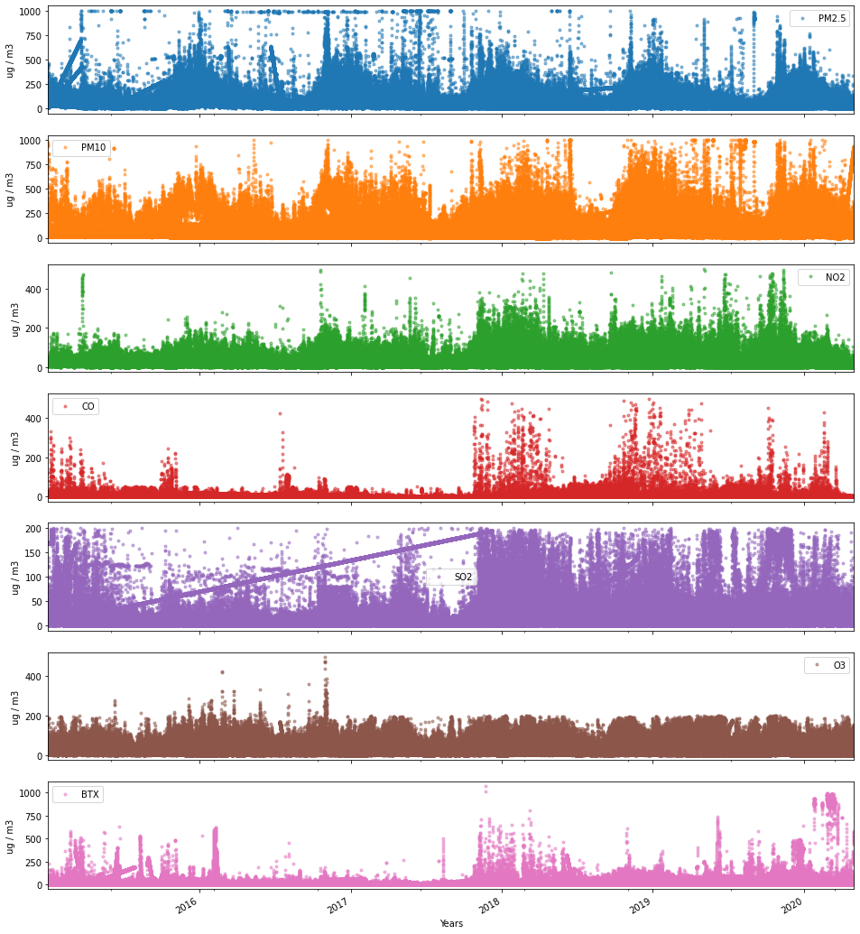
Visualising the yearly data
Notes:
PM2.5 and PM10 pollution show a seasonal effect, with pollution being higher in winter months as compared to the summer ones.
SO2 and CO level has started increasing after 2017, although it had also seen a sudden rise in 2015 also. The same pattern is also reflected in BTX levels also.
PM2.5 and PM10 pollution show a seasonal effect, with pollution being higher in winter months as compared to the summer ones.
SO2 and CO level has started increasing after 2017, although it had also seen a sudden rise in 2015 also. The same pattern is also reflected in BTX levels also.

Slide 5
PM2.5 and PM10 pollution show a seasonal effect, with pollution being higher in winter months as compared to the summer ones.
SO2 and CO level has started increasing after 2017, although it had also seen a sudden rise in 2015 also. The same pattern is also reflected in BTX levels also.

Slide 6
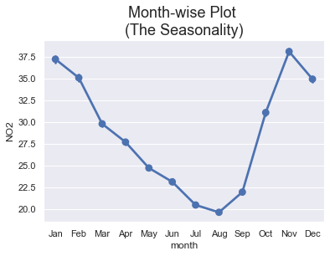
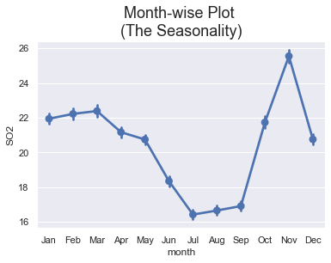
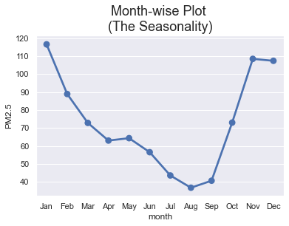
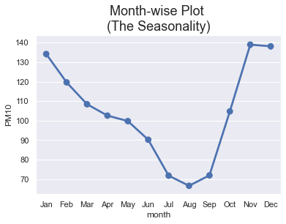
2. Seasonality trends of different pollutants
1.
2.

Slide 7
There is a clear trend that pollution level in India falls in the month of July and August. This might be majorly because monsoon season sets in during these months.
BTX levels additionally show a major decline around April.
The pollution level then start rising and reach highest levels in winter months. Again, its during these months that a lot of crop residue burning takes place, especially in northern parts of India

Slide 8
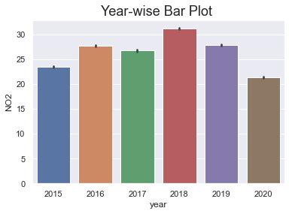
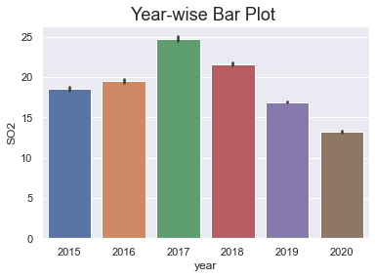
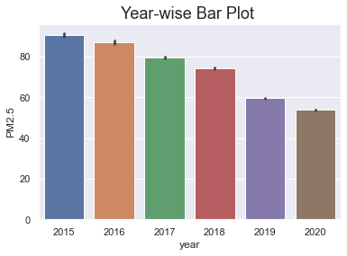
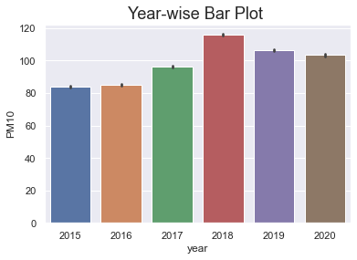
3. Year Wise Plots
Notes:
The values of 2020 are generally less as compared to other years giving us a sense that there might be a reduction on pollution during the lockdown.

Slide 9
4. Effect of Lockdown on AQI
The black vertical line shows the date on which the first phase of lockdown came into effect in India.
Clearly, there appears to be a rapid decline after 25th March,2020 in all the cities under consideration.
From the visualization, we can analyse the quality of Air in the given cities:
Place Before After
Delhi Poor Moderate
Mumbai Moderate Satisfactory
Ahmadabad Very Poor Moderate

Slide 10
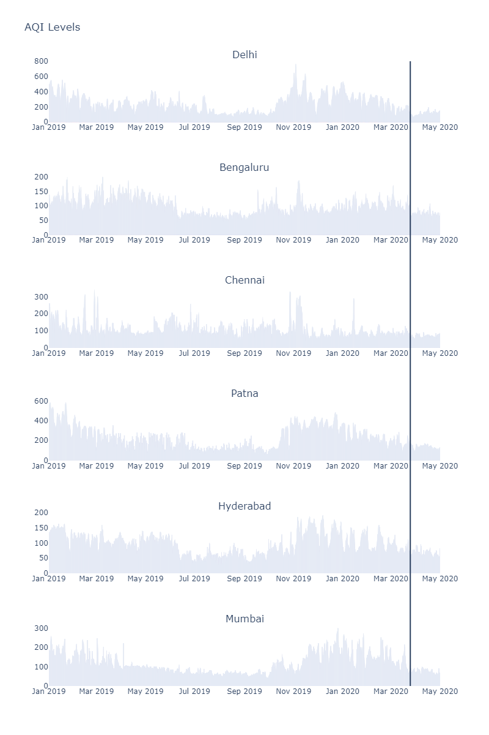

Slide 11
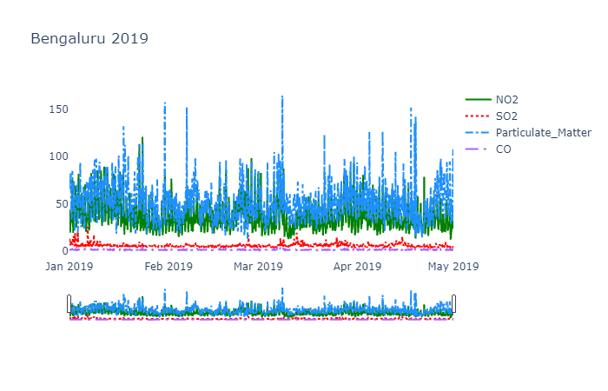
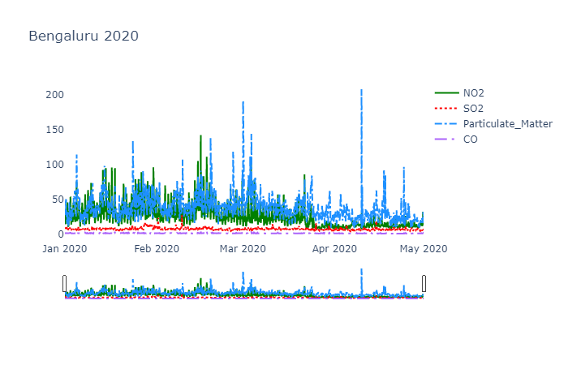
5. AQI Before and After Lockdown 1. Bengaluru

Slide 12
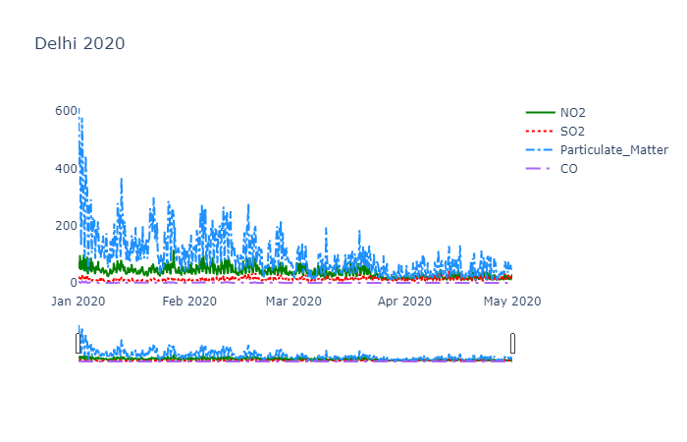
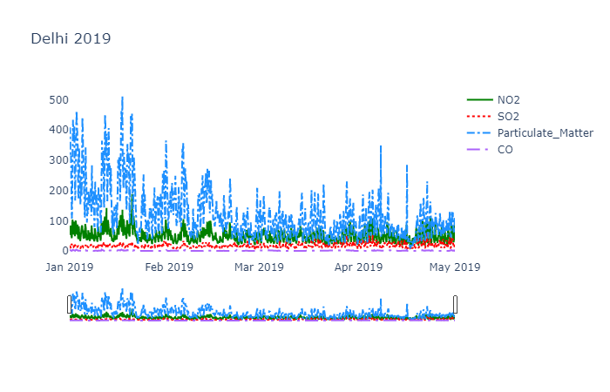
2. Delhi

Slide 13
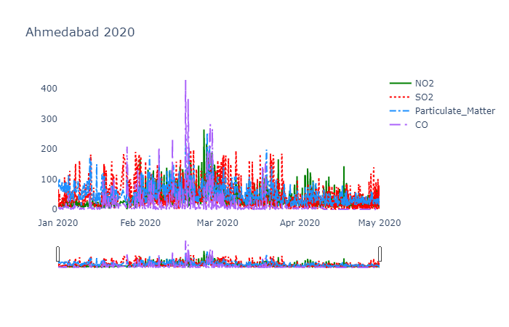
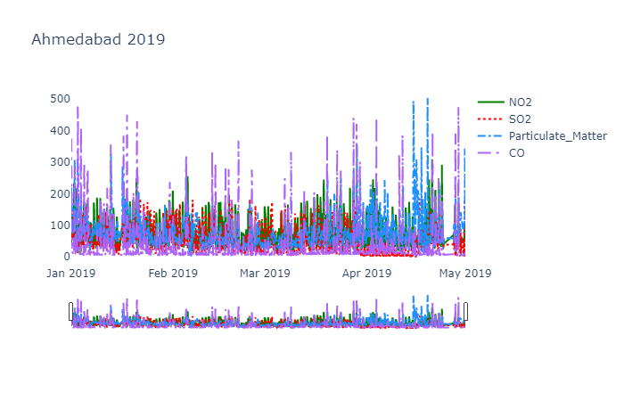
3. Ahmedabad

Slide 14
CONCLUSION
The nationwide lockdown due to the pandemic has led to a drastic decline of NO2 emissions and reduced air pollution levels. It’s important that this is maintained even after the lockdown gets over.
It’s important that when India’s lockdown will end and people return to their normal routines, they should not go back to their old behaviour. To make the current drops in air pollution levels permanent, serious policy change needs to be enacted. The reduction in road transport and the correlated decrease in air pollution have highlighted that gas-powered cars are key drivers of air pollution. Electrifying transport, expanding public transportation, building more bike lanes, and finding other ways to incentivise people to ditch their cars would dramatically reduce India’s emissions from its primary human source of air pollution. It’s also crucial that these electric vehicles , and India’s cities more broadly, are powered by clean sources of energy rather than fossil fuels.

